Slide 1
PRICE PREDICTION OF HOME
Submitted by :
YaSH KUMAR (20bcs7923)
DEBASHISH NATH (20bcs7965)
Ankit kumar (20bcs7935)
PARTH RASTOGI (20BCS5770)
SUBMITTED TO :
Er. Chet Ram(E12391)

Slide 2
INTRODUCTION
Data is at the heart of technical innovations, achieving any result is now possible using predictive models. Machine learning is extensively used in this approach. Machine learning means providing valid dataset and further on predictions are based on that, the machine itself learns how much importance a particular event may have on the entire system based on its pre-loaded data and accordingly predicts the result. Various modern applications of this technique include predicting stock prices, predicting the possibility of an earthquake, predicting company sales and the list has endless possibilities. For our research project, we have considered Mumbai as our primary location and are predicting real-time house prices for various localities in and around Mumbai.

Slide 3
We have used parameters like 'square feet area', 'no. of Bedrooms', 'No of Bathrooms', 'Type of Flooring', 'Lift availability’, ‘Parking availability' ,'Furnishing condition'. We have considered a verified dataset with diversity so as give accurate results for all conditions. We have used various algorithms explained below in various combinations and the weight for each algorithm is given based on the accuracy percentage. After evaluating for various test runs, we conclude that instead of an individual algorithm a series of algorithm yields better results.

Slide 4
objective
The main objectives of this study are as follows:
•To apply data pre-processing and preparation techniques in order to obtain clean data
•To build machine learning models able to predict house price based on house features
•To analyse and compare model’s performance in order to choose the best model

Slide 5
TECHNOLOGY USED
Machine Learning
Machine learning is a type of artificial intelligence that allows software applications to become more accurate at predicting outcomes without being explicitly programmed to do so. Machine learning algorithms use historical data as input to predict new output values.
Python
Python is an interpreted, object-oriented, high-level programming language with dynamic semantics. Its high-level built in data structures, combined with dynamic typing and dynamic binding, make it very attractive for Rapid Application Development, as well as for use as a scripting or glue language to connect existing components together.
Django
Django is a Python framework that makes it easier to create web sites using Python. Django takes care of the difficult stuff so that you can concentrate on building your web applications. Django emphasizes reusability of components, also referred to as DRY, and comes with ready-to-use features like login system, database connection and CRUD operations .

Slide 6
TECHNOLOGY USED
HTML
HTML stands for Hyper Text Markup Language. It is the language used for creating detailed instructions concerning style, type, format, structure and the makeup of a web page. It helps us to structure our page into elements such as paragraphs, sections, headings, navigation bars, and so on.
CSS
CSS is a design language that we use to make our web page look nice and presentable. It stands for Cascading Style Sheets, and we use it to improve the appearance of a web page. By adding thoughtful CSS styles, we make your page more attractive and pleasant for the end user to view and use.
Javascript
JavaScript controls the behaviour of the website. JavaScript was designed to manipulate web pages and it is used to create interactive functionality. Without JavaScript a website will still be functional, but in a limited way. JavaScript is what animates HTML and CSS, and it’s what brings our website to life.

Slide 7
LIBRARY USED
Pandas
Pandas is a Python opensource library that gives you a highly useful set of tools to do data analysis. Learning Pandas is a must for stepping up your Machine Learning. Pandas is an open-source library that lets us easily use data structures and data analysis tools for the Python programming language. Pandas is structured around DataFrame objects. All of our data comes into one big DataFrame where we can select out some samples or other data manipulation if wanted.
Scikit Learn
It’s a library founded by Google as a Google Summer of Code project. The name came from:sciPy Toolkit. SciKit Learn includes everything from dataset manipulation to processing metrics. Best things about SciKit Learn are the built-in algorithms for Machine Learning which we can just try out with minimal adjustments. Functions such as classification, regression, clustering, mode, model selection and others are generally built-in.
NumPy
Numpy stands for numerical python. Numpy adds support for large, multi-dimensional matrices and arrays, along with a gigantic collection of top-end mathematical functions to operate on these arrays and matrices. It’s objective is to make it easier for you to transform difficult functions or calculate some data analysis. Numpy’s biggest advantage is its fastness. It’s so much faster than using the built-in Python’s functions.

Slide 8
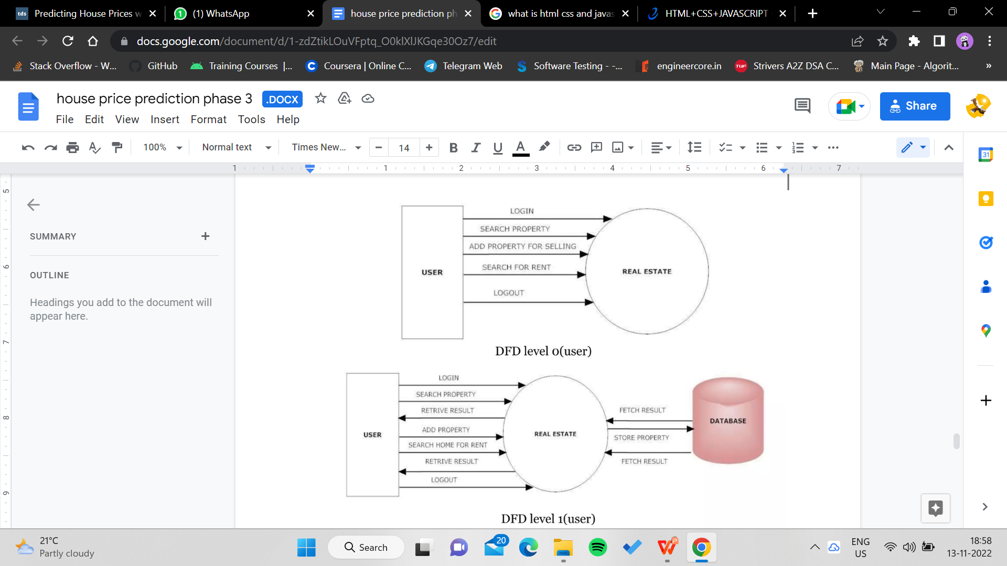
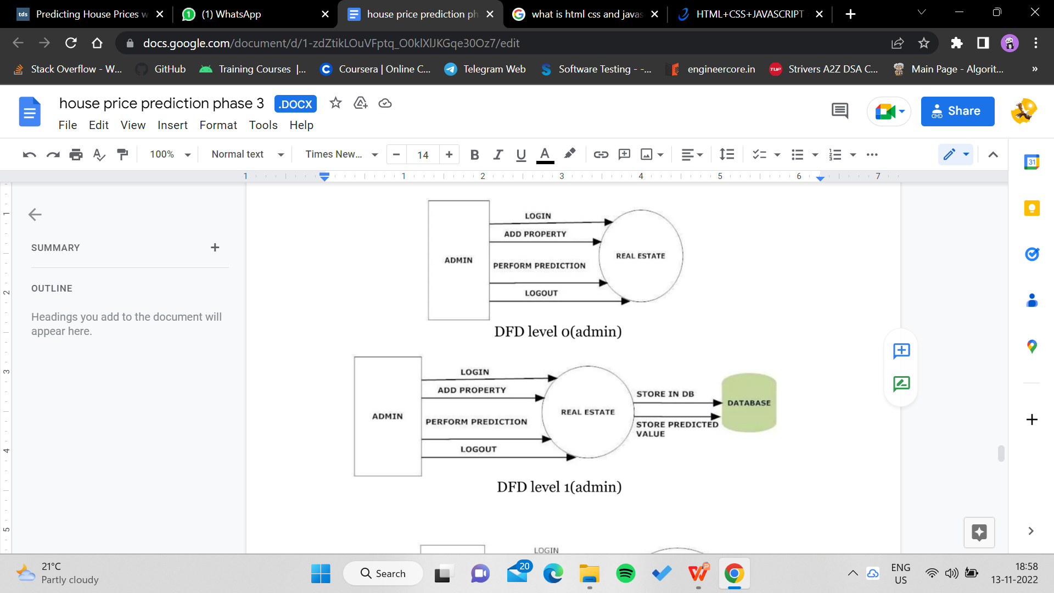
DESIGNS (Diagrams DFD , ERD)
  Data Flow Diagram

Slide 9
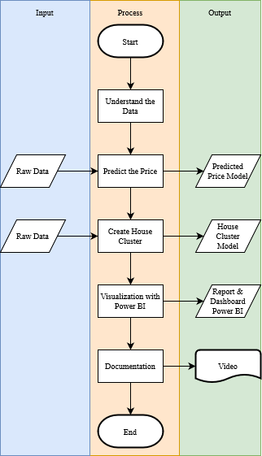
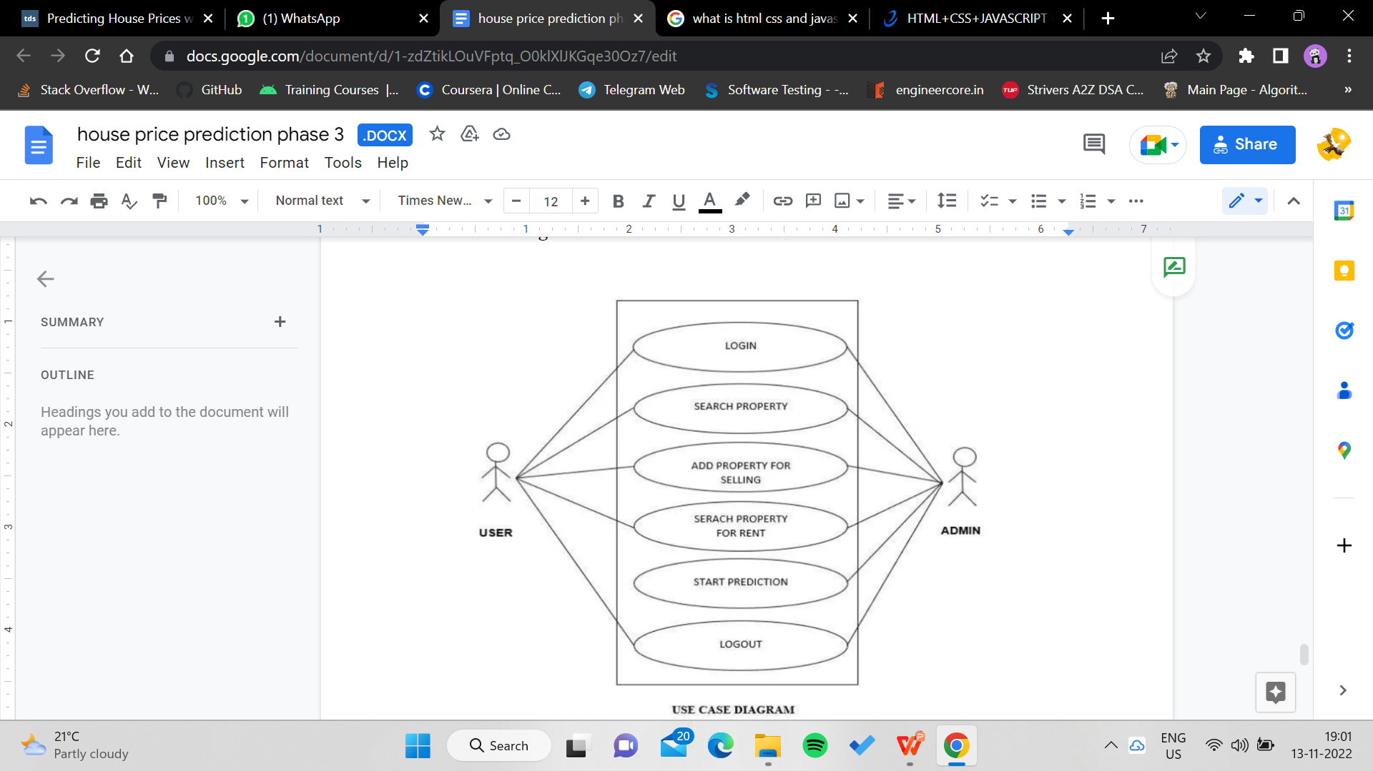
DESIGNS (Diagrams DFD , ERD)
  ER Diagram
Use case diagram:

Slide 10
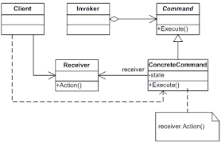
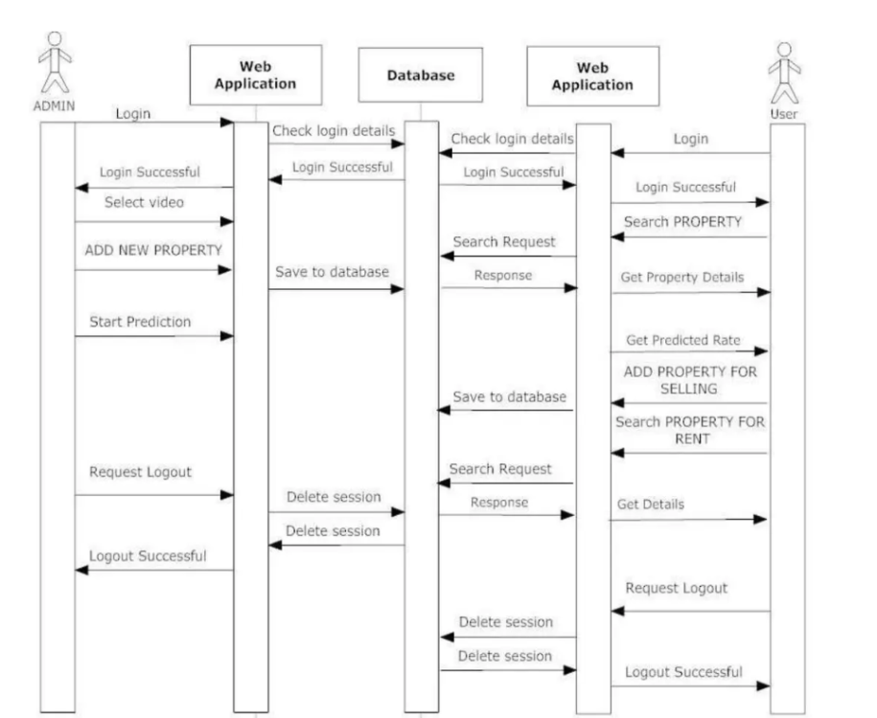
DESIGNS (Diagrams DFD , ERD)
  Class Diagram –
Sequence Diagram –

Slide 11
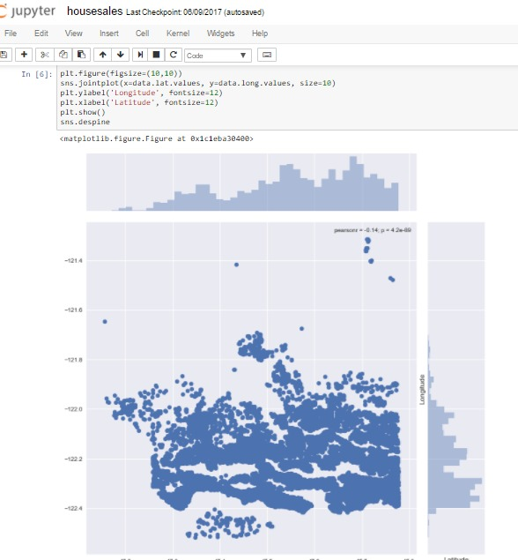
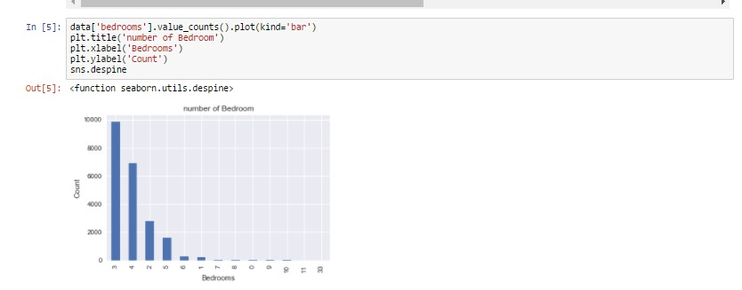
OUTCOMES
  Contact Protocol using Twilio API
Location tracker using Google Map API

Slide 12
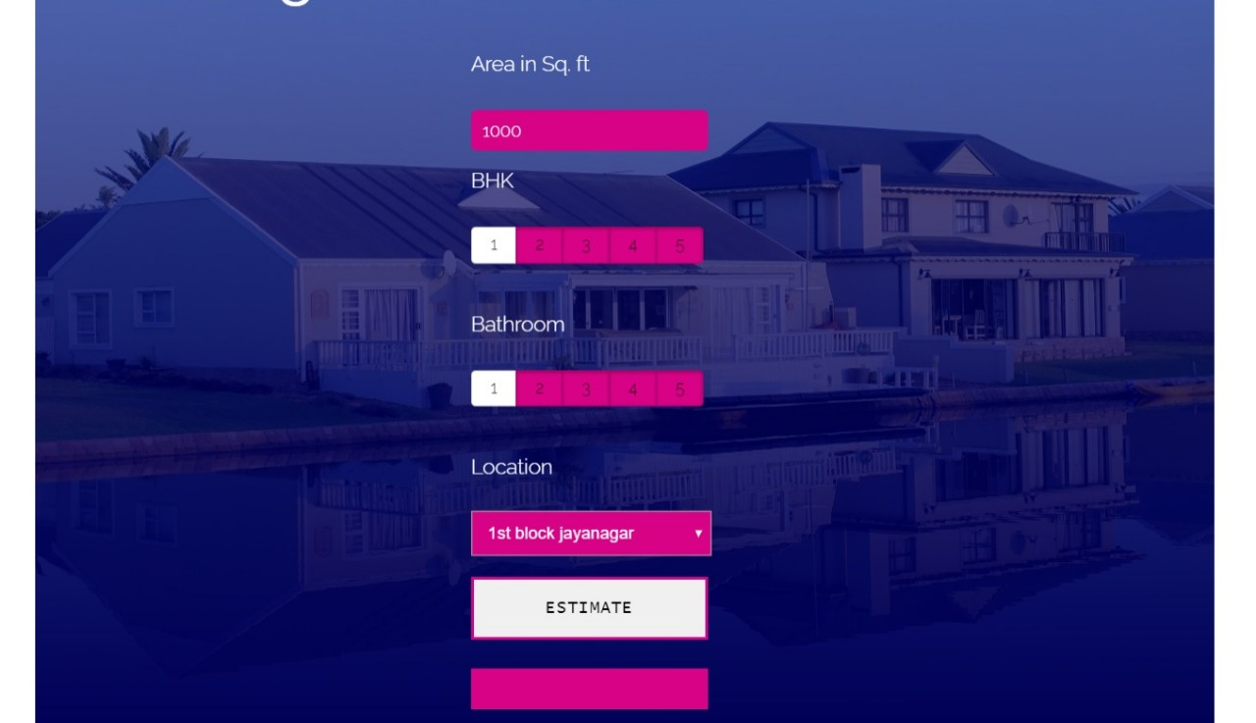
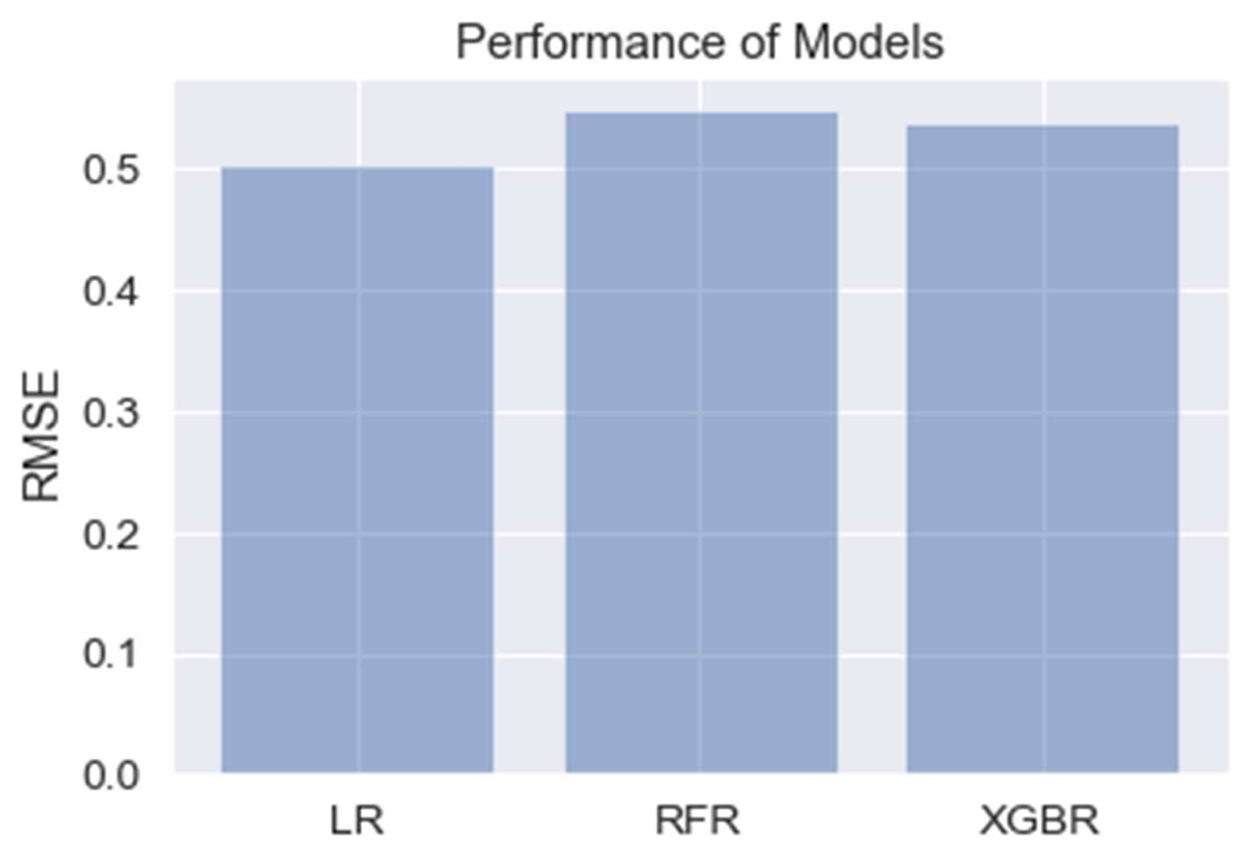
OUTCOMES
Edit File Functionality
  Terminal SHELL Menu

Slide 13
OUTCOMES
  Our problem statement wass to solve problem for the people who is new comers and want to buy house in differnt cities , for eg. here we have taken example of Mumbai. We are developing the algorithm for price prediction of home in such a way that it is attractive, user friendly and helpful. So, we design it through different diagrams like ER diagram, UML Case diagram, sequence diagram and class diagram. We divided our project in different parts which provides us the output on the basis of different parameters like Lift availability , Parking availabilty , Furnishing condition , Hospitals , Bus Stand , Railway Station and many more criteria. We were successfully able to predict the output with maximum accuracy.

Slide 14

TEAM PPH

